Slide 1
Data Warehousing & Visualization
Background
Data warehousing and business analysis
Objectives
Build a data solution that you will use to analyse and query your data in Glue, Athena, warehouse the data in Redshift, and visualize in Amazon Quicksight. All these applications will be sitting on an S3 data lake.

Slide 2
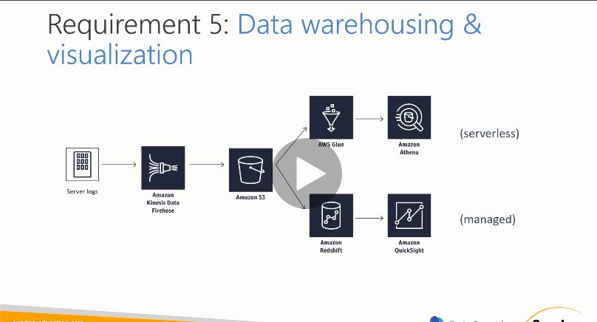
Design Solution Blueprint

Slide 3
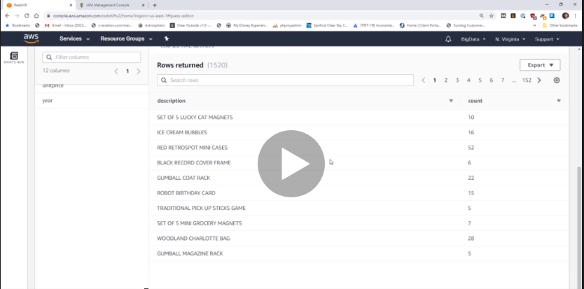
Query data using SQL in REDSHIFT

Slide 4
Process
Mechanics
Simulate order data from an EC2 instance (Use CLI and configure our logs to write into the Kinesis firehose that was created)Kinesis agent in the EC2 instance pumping the data into Kinesis Firehose delivery stream.
Publish that data using Kinesis Firehose into data lake hosted in Amazon S3 (Configure your buffer size and buffer interval in S3). The least amount of time for buffer interval is 60s.
Spin up an AWS Glue and use the Glue crawler to infer a schema from our S3 data lake (CSV files). Glue crawler will make a table out of it
Issue queries using Athena as if it were a SQL database.
Spin up a Redshift cluster with a fixed number of servers. Use Amazon Redshift Spectrum to access S3 from AWS Glue.
Spin up Amazon Quicksight which in turn is looking at data coming out of S3 data lake via Redshift

Slide 5
Security
Create a new role for Kinesis Firehose to access our S3 bucket. (Default policy for Kinesis Firehose gives it access to Kinesis Data Streams, AWS Lambda and Amazon S3)
Create a new role for our EC2 instance and give it an Administrative Access role so that it can read and write to most services.
Create an IAM role in Glue so that it can talk to S3
Create an IAM role for Redshift to be able to talk to AWS Glue(AWSGlueConsoleFULLAccess) and S3 (AmazonS3ReadAccessonly)

